Slide 1




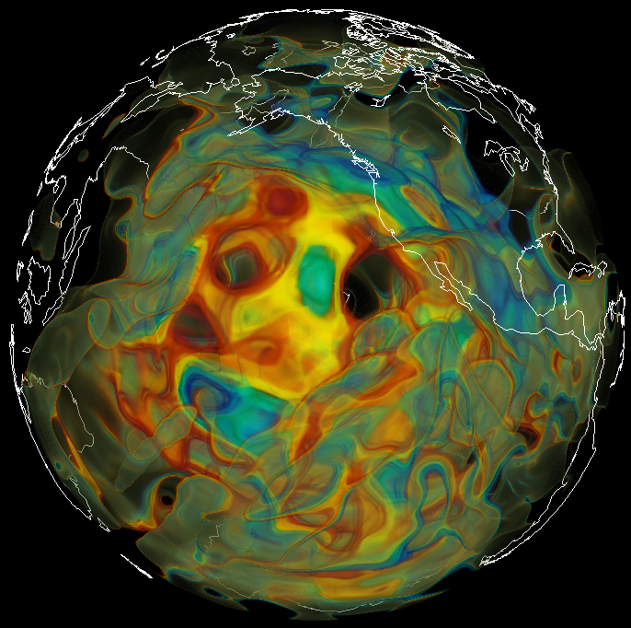
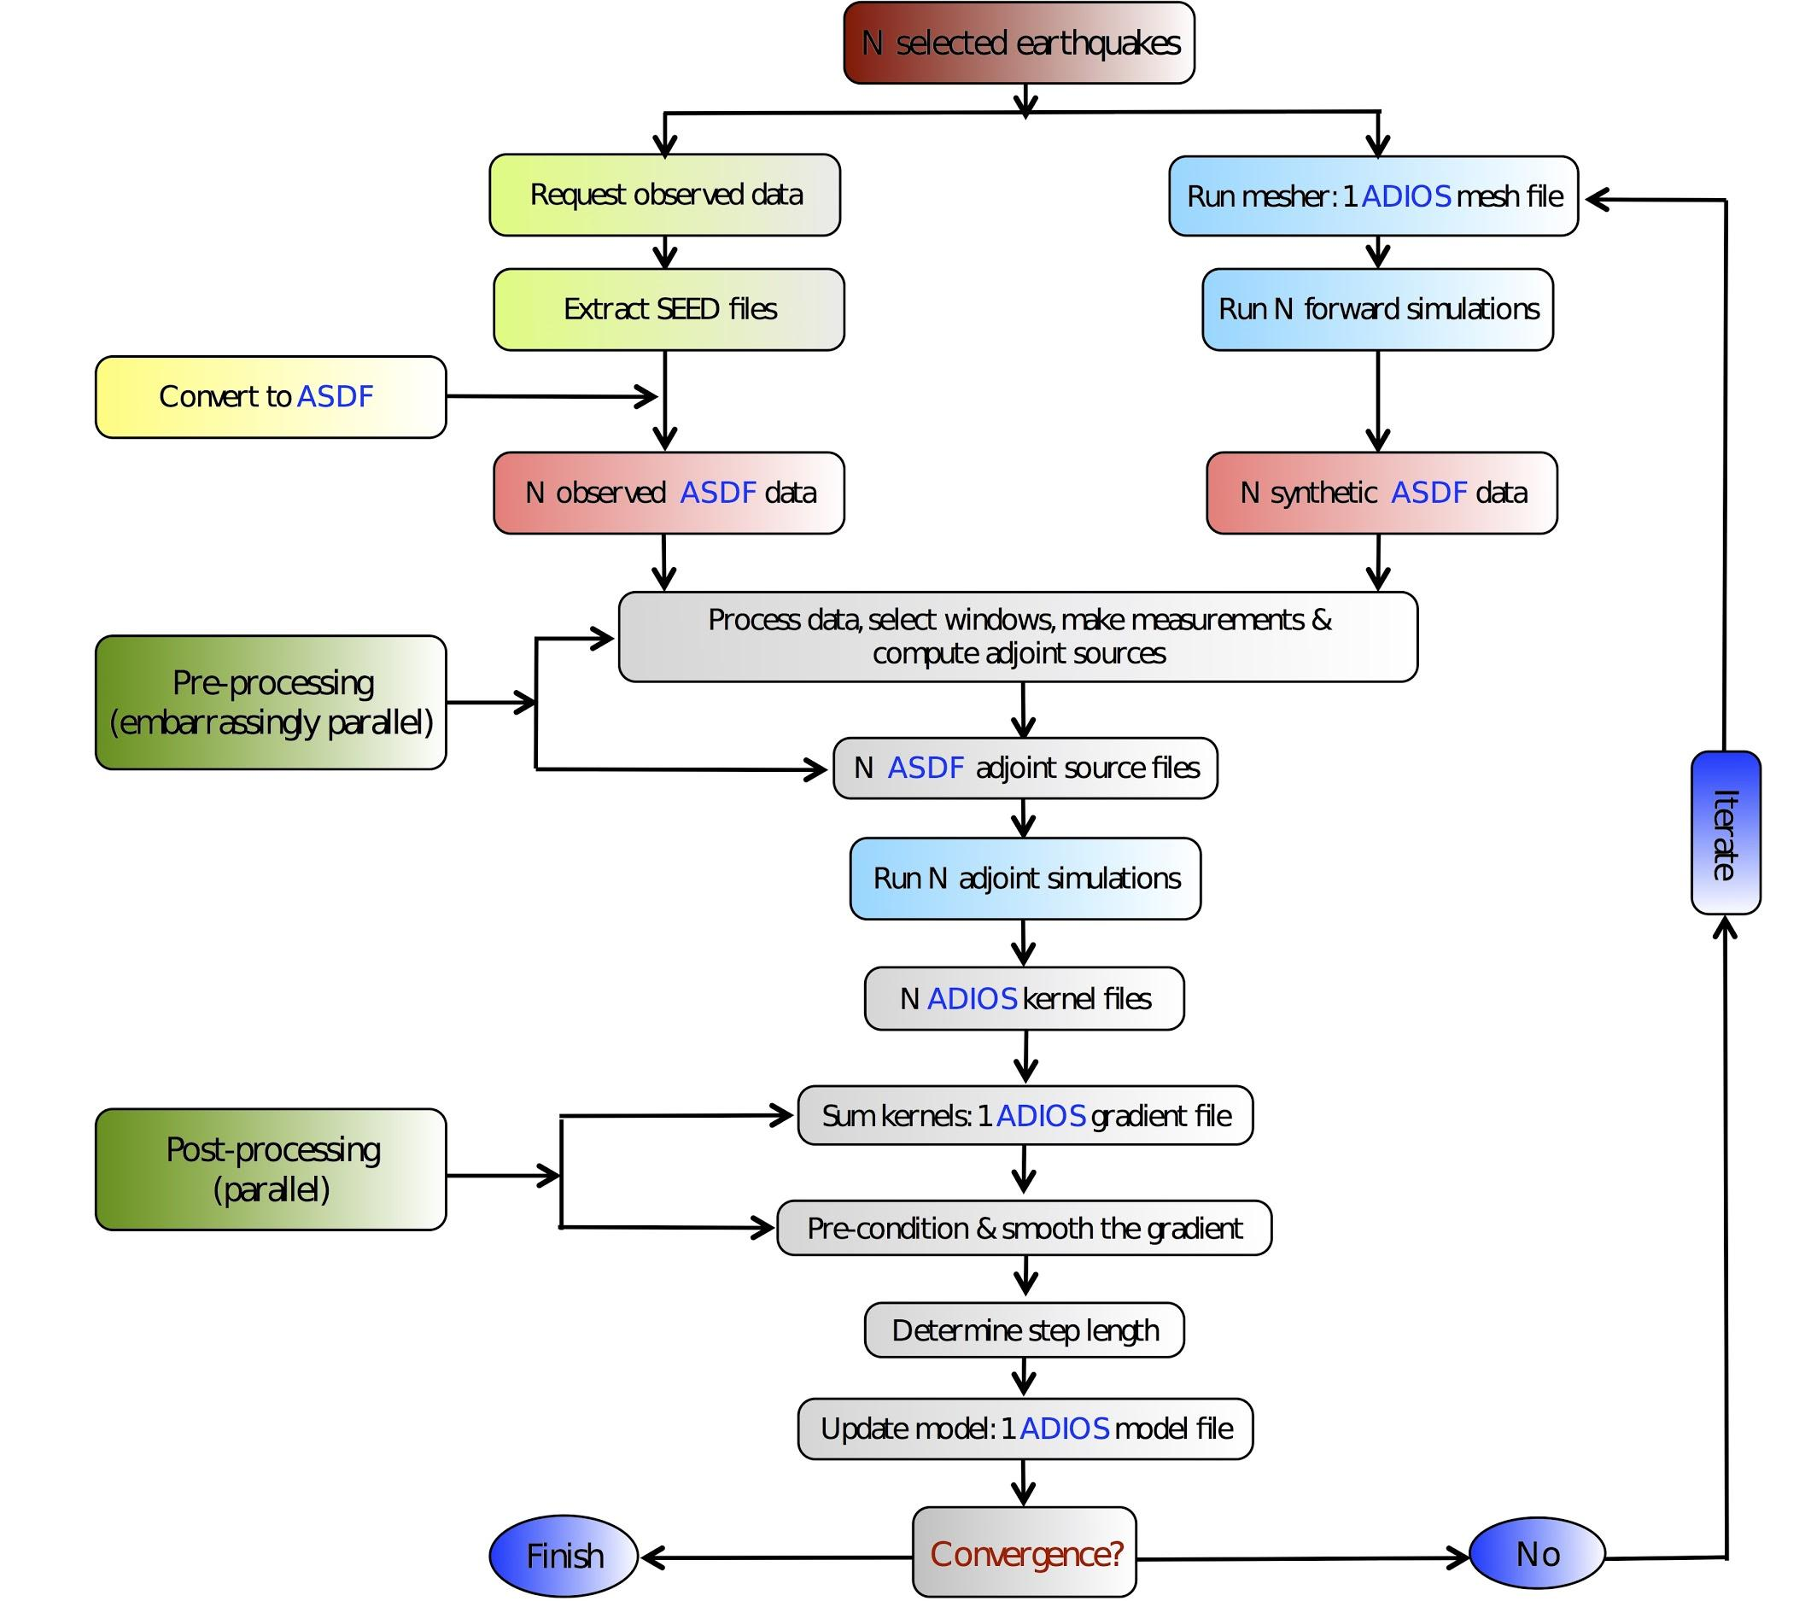
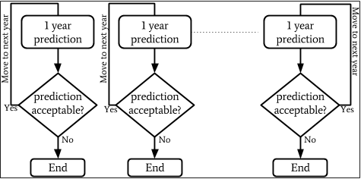
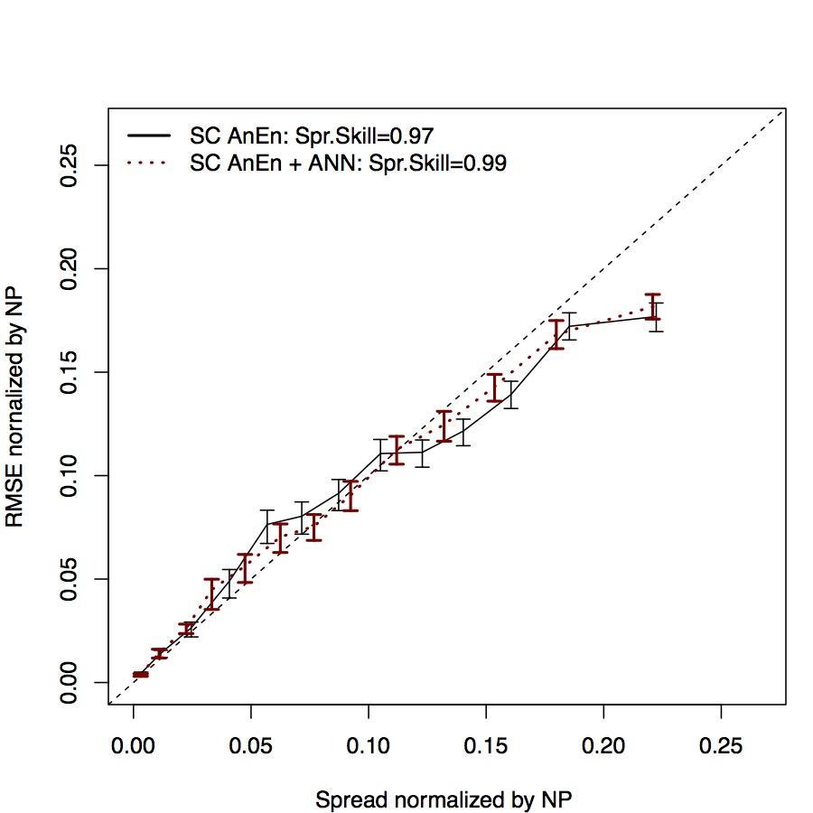
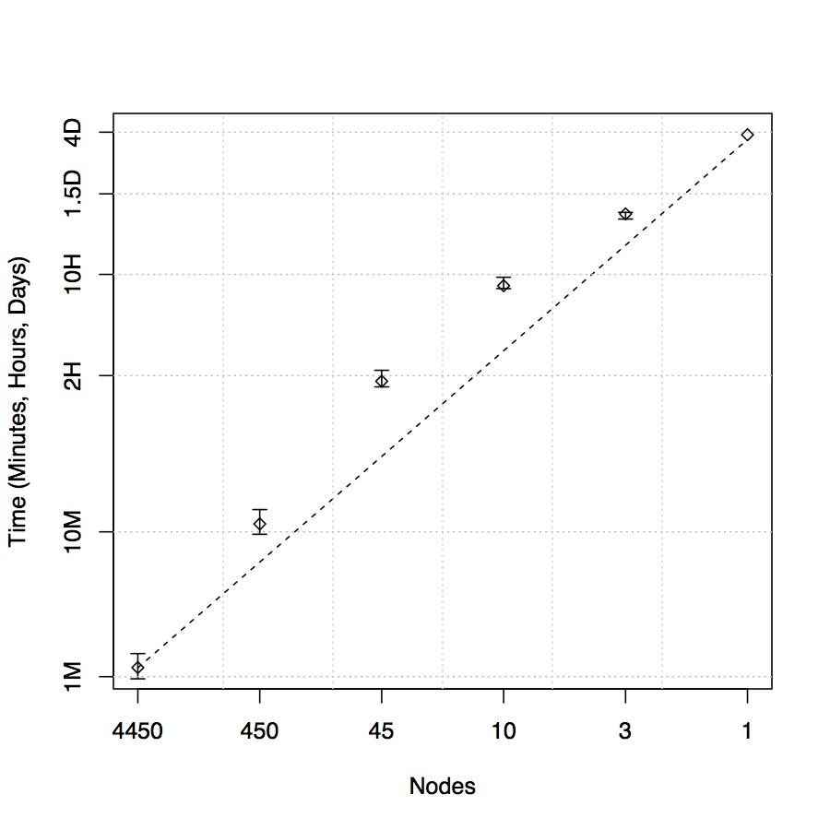
Power of Many: Ensemble Toolkit for Earth Sciences
V. Balasubramanian, M. Turilli, S. Jha W. Hu, M. Mann, G. Cervone M. Lefebvre, W. Lei, R.Modrak, J. Tromp
ICER 1639694
Lightweight toolkit to execute and manage ensemble-based workflows on high-performance computing infrastructure
Project Objective
Create specialized computational tools that will enhance the ability of scientists to effectively and efficiently study, using high-performance computing systems, a) seismic phenomenon to gain knowledge of earth’s interior and b) climate behaviour to understand the potential of photovoltaic energy. The use of these tools will support novel methods and the use of powerful computing resources
Science Driver 1: Seismic Tomography
Overarching Goal:
Automate Seismic Inversions, in particular, Global Earth Tomography;
Workflow based on:
SPECFEM3D_GLOBE, a highly parallel elastic wave equation solver based on spectral elements;
Adjoint methods to assimilate
seismic data and iteratively
improve the initial
earth model;
Three Critical Requirements,
one Toolkit!
Ensemble Toolkit
D. Pugmire
Automation
Scale
Robustness
Challenges:
Assimilate large amounts of data, containing up to 6000 earthquakes, each recorded by several thousands receivers;
Provide resiliencies for large inversions on leadership-class supercomputers;
Enable the broader community by providing abstractions to common seismic workflows.
Enable capability to encode application logic via toolkit components such that user involvement in execution of the various sections of the workflow is minimal. This is important for large, long running workflows such that there is no time lost in waiting for manual input.
The scale at which current domain science problems have to be solved has grown leaps and bounds. Ensemble toolkit is being designed to support problems requiring O(10⁵) tasks. End goal of the roadmap is to support O(10⁶) tasks.
At scales of O(10⁵) tasks, it becomes imperative to be able to handle failures. This includes, both, failures at the level of the executing kernel as well as the components of the toolkit. The toolkit is designed to be recover from a known set of perturbations or, in the case of unknown errors, terminate with minimal information loss
E. Bozdag
Science Driver 2: Climate Impacts on Photovoltaic Energy
Overarching Goal:
Identify challenges in generating photovoltaic energy under different climatic conditions;
Workflow based on:
AnEn: Analog Ensemble methodology that performs a dynamic downscaling of climatic simulations using historical mesoscale forecasts, and generates probabilistic predictions from deterministic forecasts;
A photovoltaic model that predicts the amount of energy generated given meteorological condition inputs;
Challenges:
Assimilate large amounts of climatic simulations data for the past 20 years, and downscale them using historical forecasts from a mesoscale model;
Use Analog Ensemble methodology and a photovoltaic model to generate long-term probabilistic predictions for photovoltaic energy;
Define a 2-dimensional metric that measures the similarity between forecasts to improve Analog Ensemble performance.
Ensemble toolkit is a workflow execution system that, in addition to the above requirements,
provides generic building block components that encourage a lego-style application creation process.
take responsibility of efficient execution on different heterogeneous HPC systems.
Design of the toolkit:
user facing components (blue) to create the application
workflow management components (purple) to manage the execution order of the individual tasks of the application
workload management components (red) to manage resources and task execution via a runtime system (green)
Resource
Handle
Pipeline
Application Manager
Stage
Task
Ensemble Toolkit
Execution Manager
RADICAL Pilot
Other RTS

